Slide 1
Used car price prediction
STAT 432 Final Project
Eunjeong Ro | Henu Park | Nicholas Choi

Slide 2
INDEX
1. Introduction
Project Description | Literature Review | Overview
2. Methodology
Data processing | Regression | Random forest | KNN
3. Results
Model Performance | Prediction | Key features Importance
4. Conclusion

Slide 3
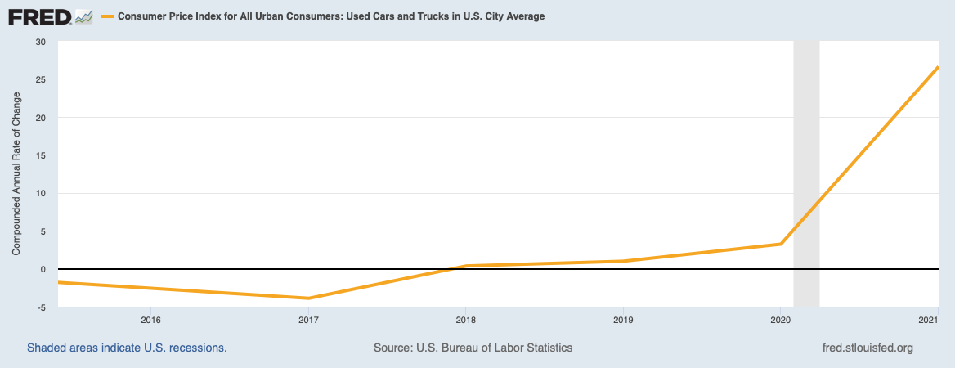
Introduction
Project Description
From the onset of Coronavirus pandemic, the U.S used car market has seen unprecedented rate of increase in the second-hand automobiles’ prices.
Source: FRED (https://fred.stlouisfed.org)
Notes:
This phenomenon is mainly attributed to two causes: decreased production by automakers due to microchip shortages and increased demand from consumers returning to work.

Slide 4
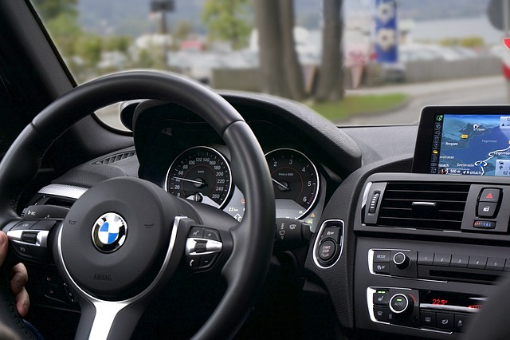
Introduction
Project Description
Machine Learning
Algorithm
Covid-19
Price
Prediction
Notes:
With used car prices being higher than pre-Covid times, sudden changes in consumer behavior and supply of key components have caused unprecedented changes within the market.
Such variation has made it difficult to apply forecasting methods such as that of Time-series analysis and required forecasting method that can be conducted with data at hand.
Through out this project we will compare different ML algorithms that have been applied to identify factors that are having high influence in used car valuation and rate their performance.

Slide 5

Introduction
Literature Review
Paper 1
Paper 2
Comparative analysis of
used car price evaluation models
Predicting Used Car Prices
By Chuancan Chen, Lulu Hao, Cong Xu
By Kshitiji Kumbar, Pranav Gadre, Varun Nayak
100,000 used car data from China
Used car data from Kaggle
Linear regression
Random forest
Linear regression
Random forest
KMeans
Gradient Boost
LightGBM
XGBoost
Notes:
432 Reference
Comparative analysis of used car price evaluation models
Compared the performance of Linear Regression and Random Forest when forecasting on 100,000 used car data from China
In the universal setting, Random forest worked better than linear regression and was able to explain 95.06% of the price variation.
Comparative analysis of used car price evaluation models
Used data available in Kaggle to compare the performance rate of 6 different algorithms.
Linear regression, Random Forest, Gradiend Boost, XGBoost, LightGBM, KMeans + Linear Regression.
The result was that Rondom Forest had great perforance level as well as acceptable training time.

Slide 6




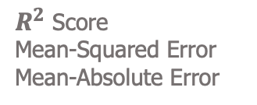
Introduction
Overview
Web scrapping
Pre-processing
Model Application
Model Evaluation
Linear regression
Polynomial regression
Random Forest
K-nearest neighbors
$R^{2}$ Score
Mean-Squared Error
Mean-Absolute Error
Data scrapped from CarGurus website
Missing Values
Encoding
Notes:
We have already explained the content of our presentation, however, we have visualized the process that we took through out our porject

Slide 7
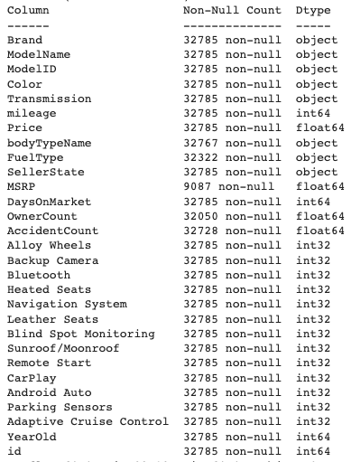
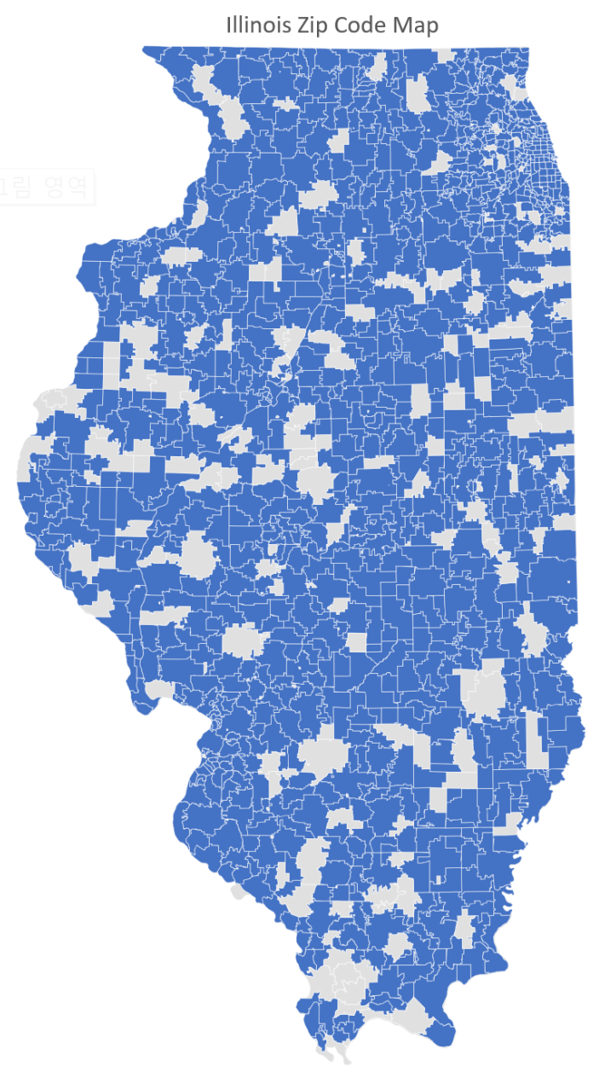
Methodology
Dataset
CarGurus
Most widely used platforms for Used car
Dataset
32,785 Observations
Features
MSRP | Model ID | Body type | Mileages etc.
States
Illinois | Iowa | Wisconsin | Missouri | Indiana
Notes:
Data -> 'IL', 'IA', 'WI', 'MO', 'IN’
Zip code -> States (3,000 different zip codes (randomly))
Why random ? ->
The reason that we were initially interest in this dataset was because we were planning to purchse a car within a few years. Hence, we wanted to look at the used car data are within the Midwesttern states that were the likely candidates of our car purhcase
We used a vector which contains randomly selected zipcodes from the Midwestern states and collected data from the corresponding zipcodes.

Slide 8
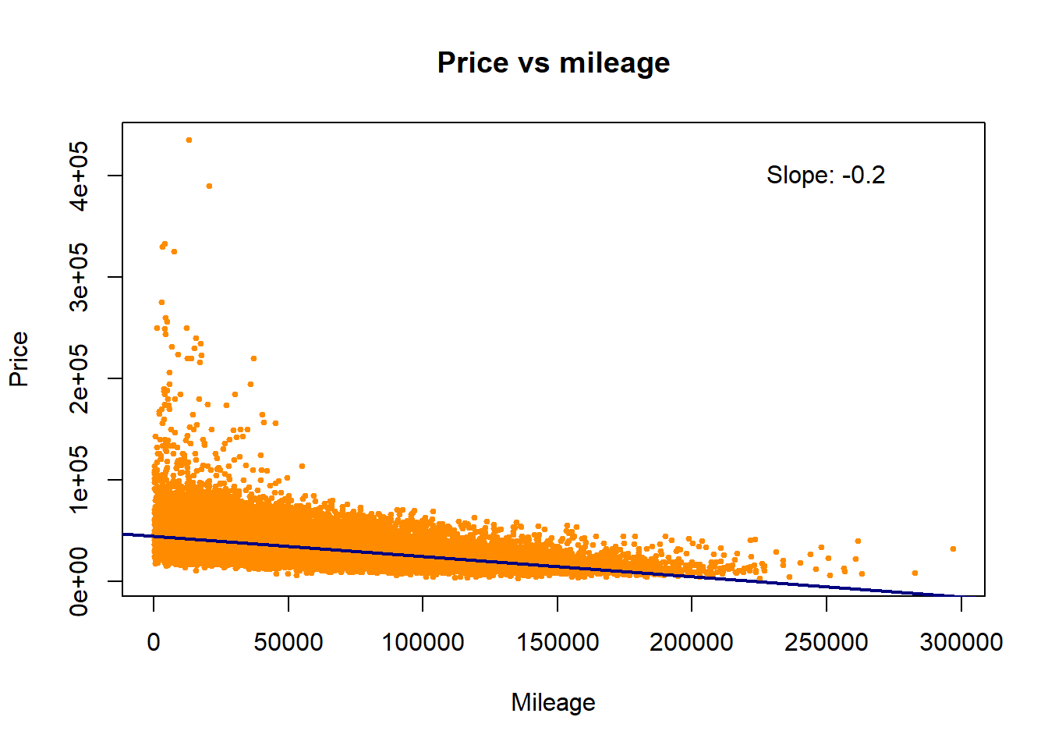
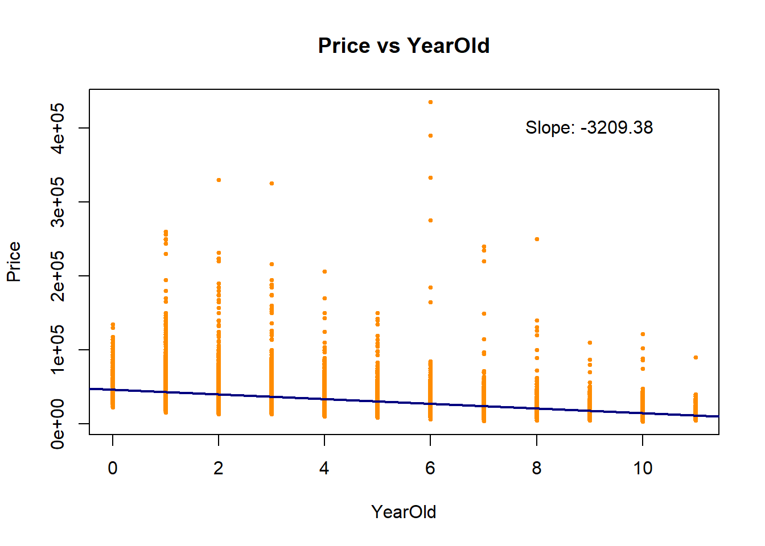
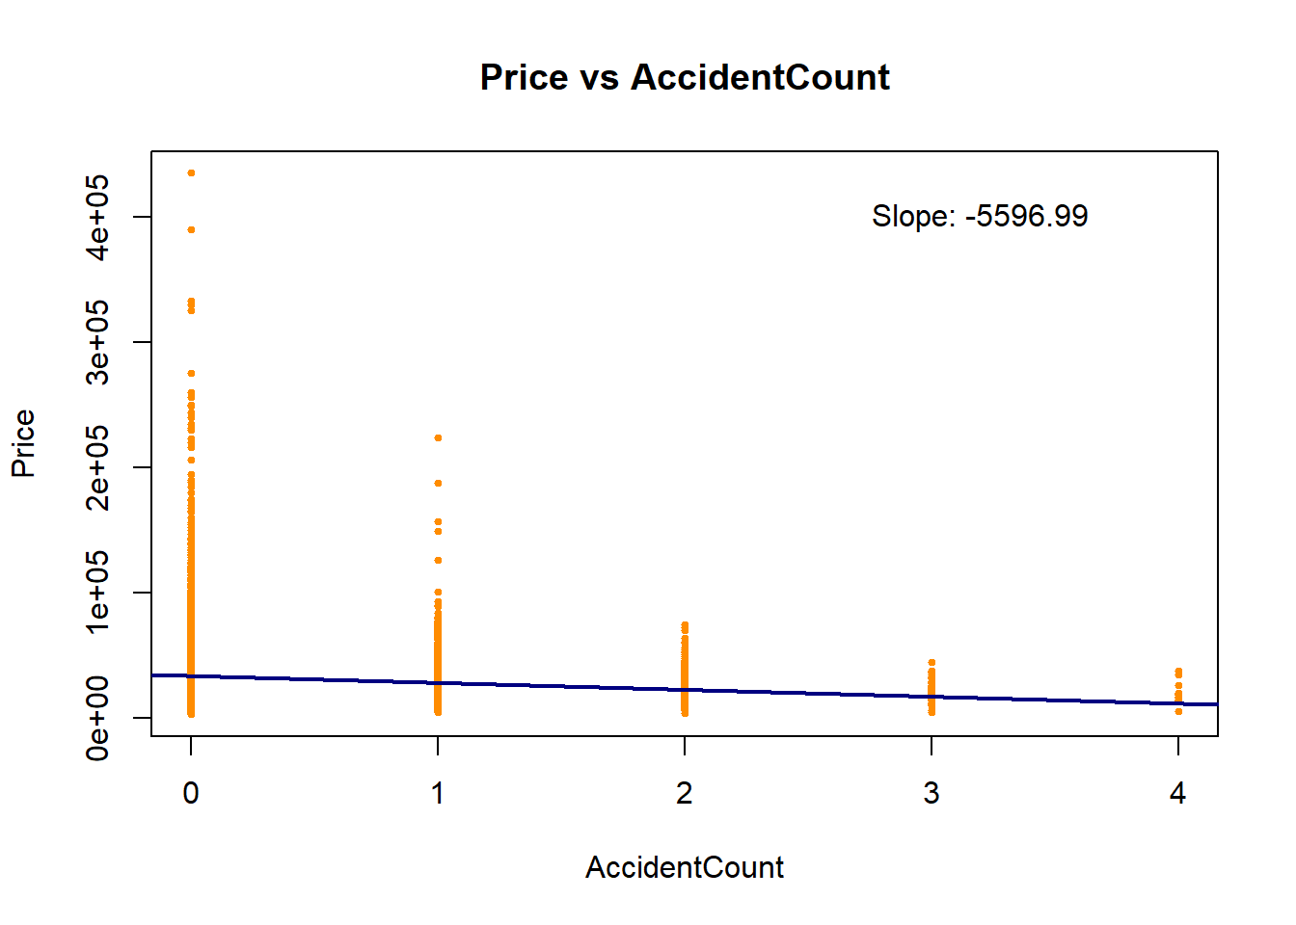
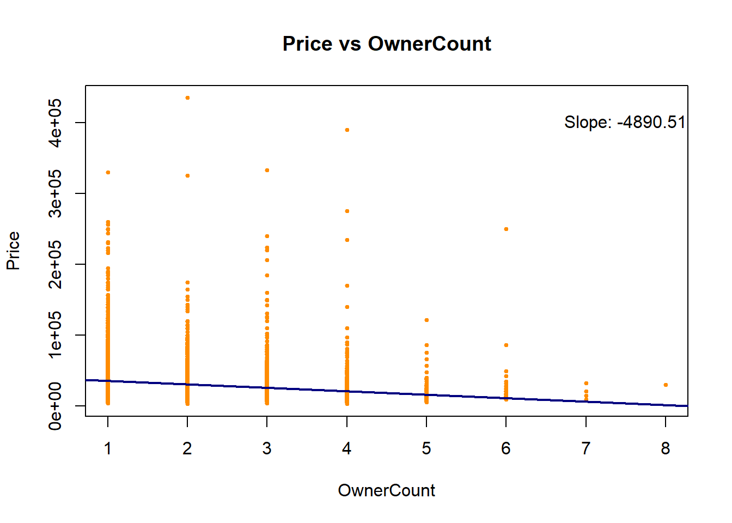
Methodology
Dataset

Slide 9
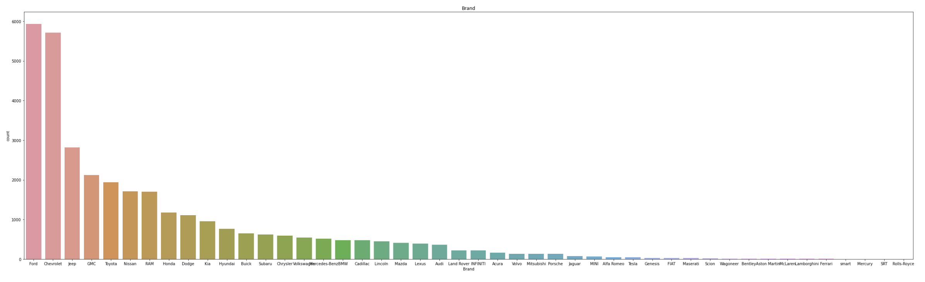
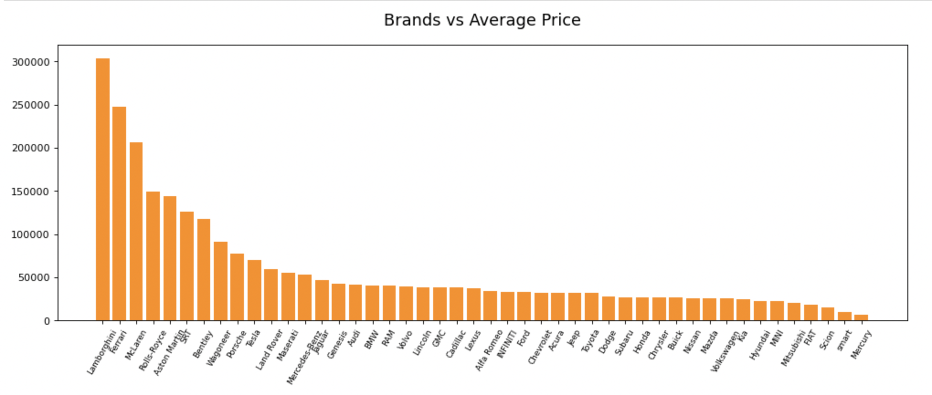
Methodology
Dataset
Brand
Brands vs. Average Price

Slide 10
Methodology
Dataset
Brand
Brands vs. Average Price

Slide 11
Methodology
Dataset
Brand
Brands vs. Average Price

Slide 12
Methodology
Dataset
Brand
Brands vs. Average Price

Slide 13
Methodology
Dataset
Brand
Brands vs. Average Price

Slide 14
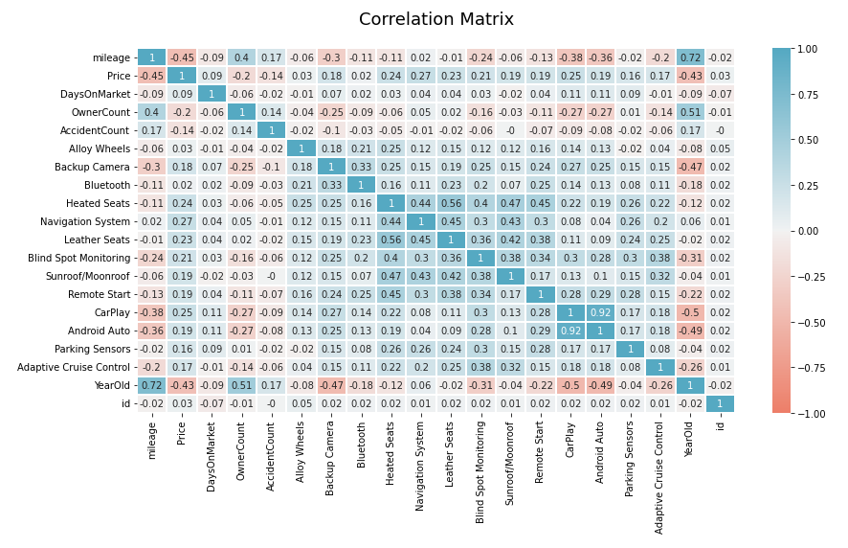
Methodology
Dataset – Correlation
Mileage
The amount of wear & tear the car has sustained
Transmission
Heated Seats | Navigation System | Sunroof etc.
Year Old
The age of the used car

Slide 15
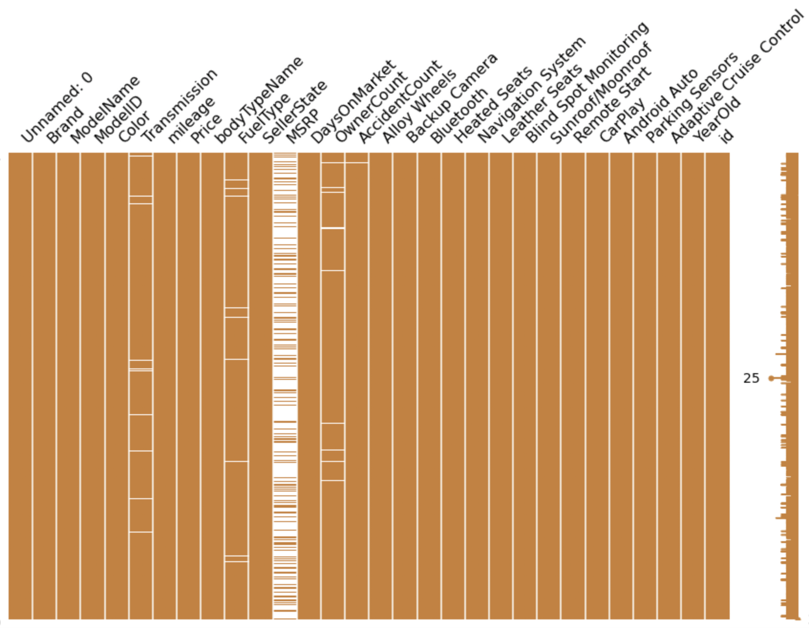

Methodology
Data Processing – MSRP
Intuition
MSRP is the key component
Reality
Too much missing observations
Adjustment
Drop the “MSRP”
Notes:
Observing the raw data that we have scraped from the Cargus website, there has been 6 variables that contain NULL values.
MSRP has the highest proportion of NULL values as 72.28% and followed by 5 others.
One of the key components that we thought that would be inlfucential in the car price prediction was MSRP. However when we scraped the data, it was found that MSRP had many values that were missing and were unable to fill the MSRP adequetly. Hence, we had to drop the MSRP and run our predictive analysis with other variables.

Slide 16
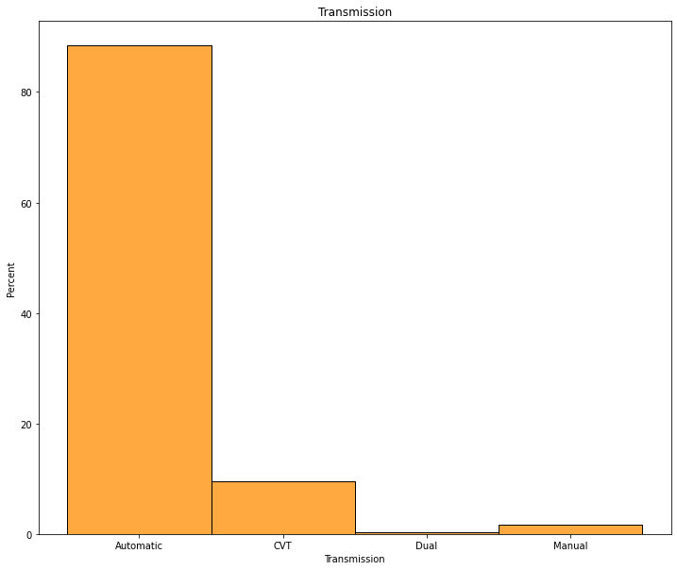
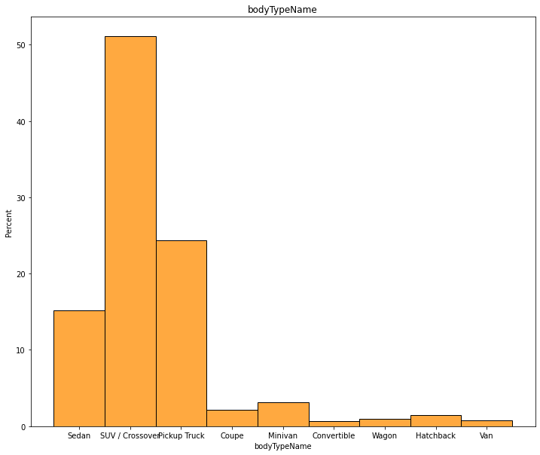
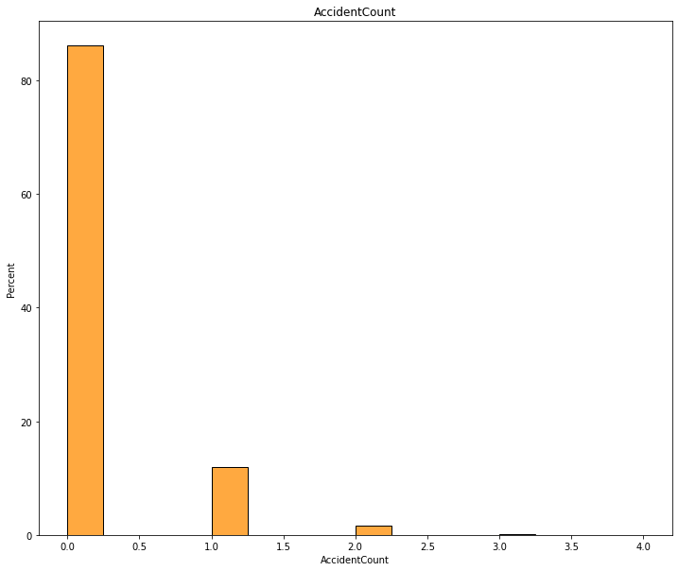
Methodology
Data Processing – Distribution of features with NULL values
Transmission
Body Type
Accident Count
Notes:
Missing values -> not too much + percentages -> average (x) => DECIDE TO DROP
Observing the raw data that we have scraped from the Cargus website, there has been 6 variables that contain NULL values.
MSRP has the highest proportion of NULL values as 72.28% and followed by 5 others.
Distribution of features with NULL values

Slide 17
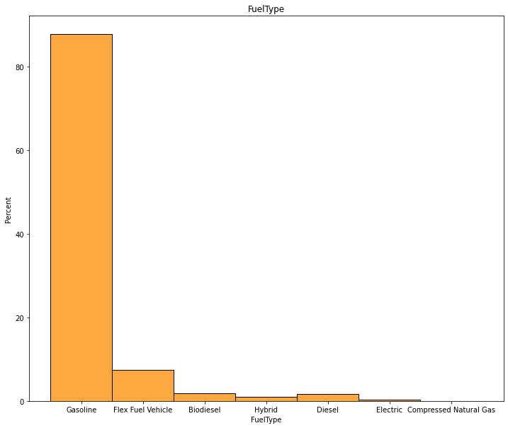
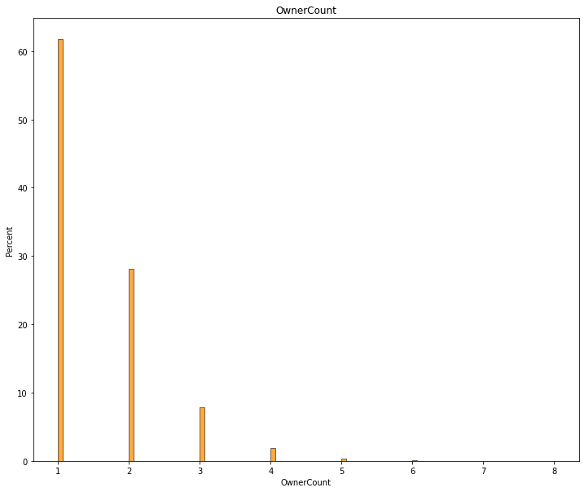
Methodology
Data Processing – Distribution of features with NULL values
Fuel Type
Owner Count
Notes:
Missing values -> not too much + percentages -> average (x) => DECIDE TO DROP
Observing the raw data that we have scraped from the Cargus website, there has been 6 variables that contain NULL values.
MSRP has the highest proportion of NULL values as 72.28% and followed by 5 others.

Slide 18
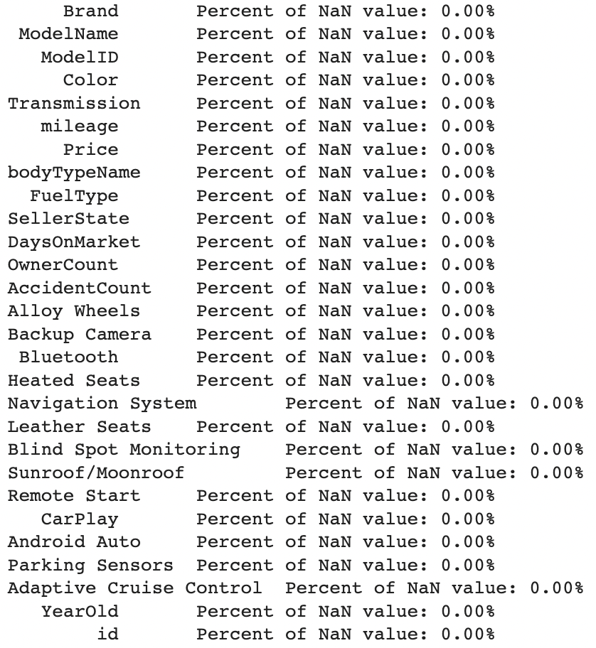

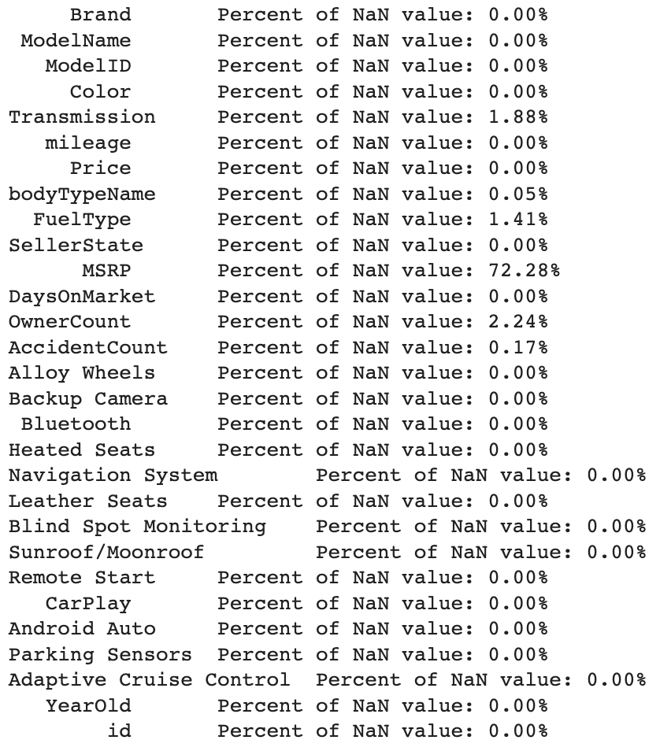
Methodology
Deleted 1,770 observations
Data Processing – Missing Values
Drop missing values
31,015 observations left
Notes:
*** ## observation dropped 32785 – 31015 = 1770
Observing the raw data that we have scraped from the Cargus website, there has been 6 variables that contain NULL values.
MSRP has the highest proportion of NULL values as 72.28% and followed by 5 others.

Slide 19
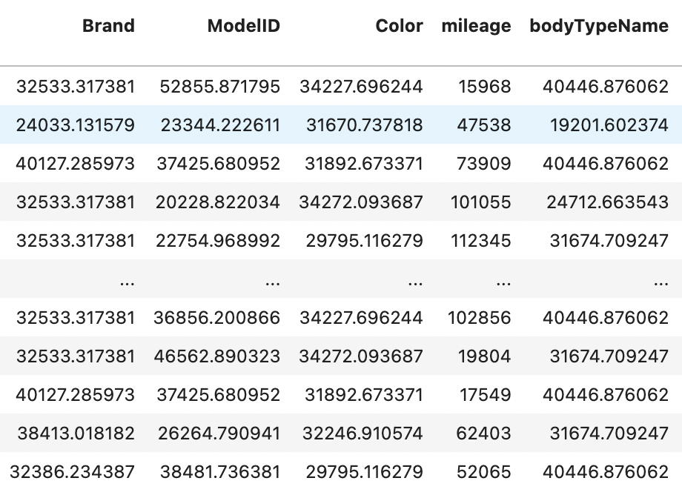
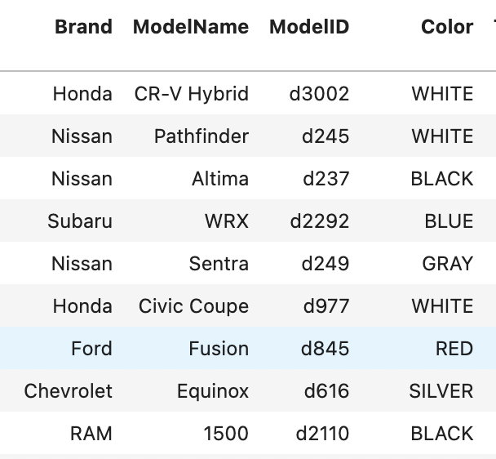
Methodology
Data Processing
Target Encoding
Brand | Model ID | Color | BodyType
Notes:
The main idea behind the target encoder is to encode the categories by replacing them for a measurement of the effect they might have on the target.

Slide 20
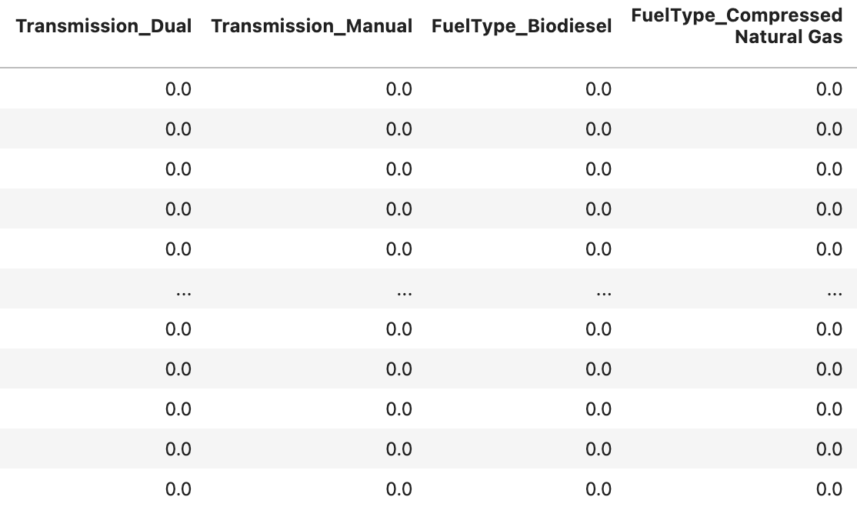
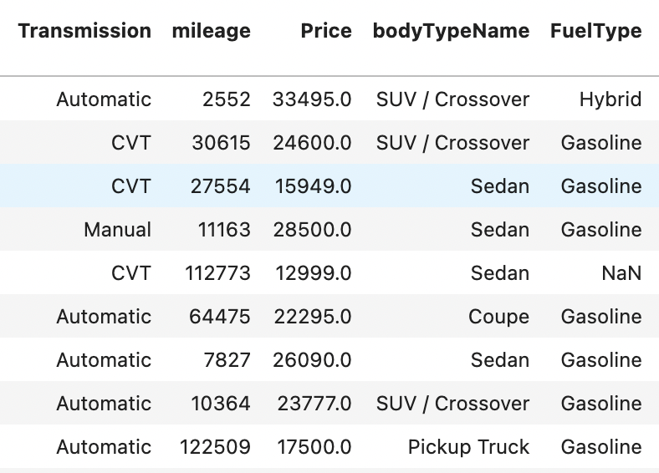
Methodology
Data Processing
One Hot Encoding
Transmission | Fuel Type
Notes:
One hot encoding makes our training data more useful and expressive, and it can be rescaled easily. By using numeric values, we more easily determine a probability for our values. In particular, one hot encoding is used for our output values, since it provides more nuanced predictions than single labels.

Slide 21
Methodology
Approach
Random Forest
Can account for numerous features while ensuring that the nodes are uncorrelated
Linear Regression
The most fundamental and essential regression possible
Modeling
Approach
K-Nearest Neighbors
Polynomial Regression
supervised machine learning algorithm that can be used to solve both classification and regression problems
Sensitive to outliers
Treat as multiple linear regression
Notes:
- Predicting Used Car Prices
1. Linear Regression: Quick to train and test as a baseline algorithm. 2. Gradient Boost: To account for non-linear relationships, by
splitting the data into 100 regions.
3. Random Forest : To account for the large number of features in the dataset and compare a bagging technique with the Gradient Boost method.
4. XGBoost: To improve performance compared to standard Gradient Boosting using regularization, second order gradients and added support for parallel compute.
5. KMeans + Linear Regression Ensemble: In order to capitalize on the linear regression results using ensemble learning,
6. Light GBM: To improve performance compared to Gradient Boosting with a leaf-wise-tree growth approach and improved speed compared to XGBoost.

Slide 22
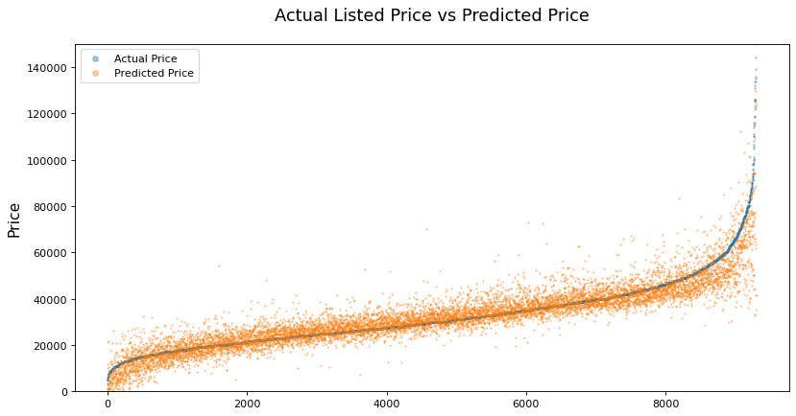

Results
Model performance
Linear Regression
$R^{2}$ score
78.51 %
MSE
59,488,734
MAE
4154.19

Slide 23
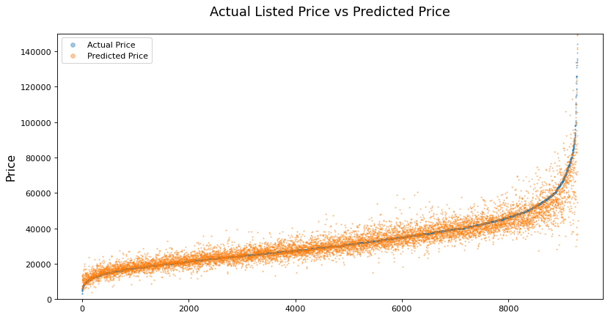
Results
Model performance
Polynomial Regression
$R^{2}$ score
83.31 %
MSE
46,202,202
MAE
3443.15

Slide 24
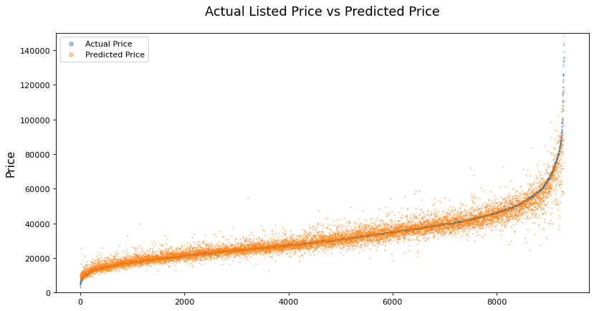
Results
Model performance
300 estimators & required sample to split = 4
Random Forest
$R^{2}$ score
89.24 %
MSE
29,780,137
MAE
2724.70
Notes:
Randomized Grid Search - > 50,100,150, 200, 250, 300, 350, 400, 450, 500
n_estimators= 300, min_samples_split=4

Slide 25
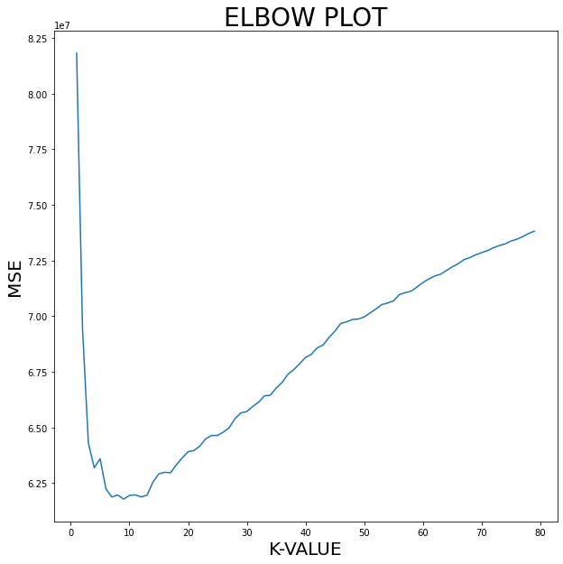
Results
Model performance
The best K-value = 8
K-Nearest Neighbors
KNN score
81.38 %
MSE
51,542,118
MAE
3843.28
Notes:
KNN analysis returned the performance accuray 0f 0.17% which is quite disappointing.
However, since the benefit of using KNN is for classification, we believe that it is not the best method of analysis for our dataset.

Slide 26

Results
Model performance
$R^{2}$ score
MSE
MAE
Linear Regression
78.51%
49,588,734
4154.19
Polynomial Regression
83.31%
46,202,202
3443.15
Random Forest
89.24%
29,780,137
2724.70
KNN
81.83%
51,542,118
3843.28
* KNN score

Slide 27
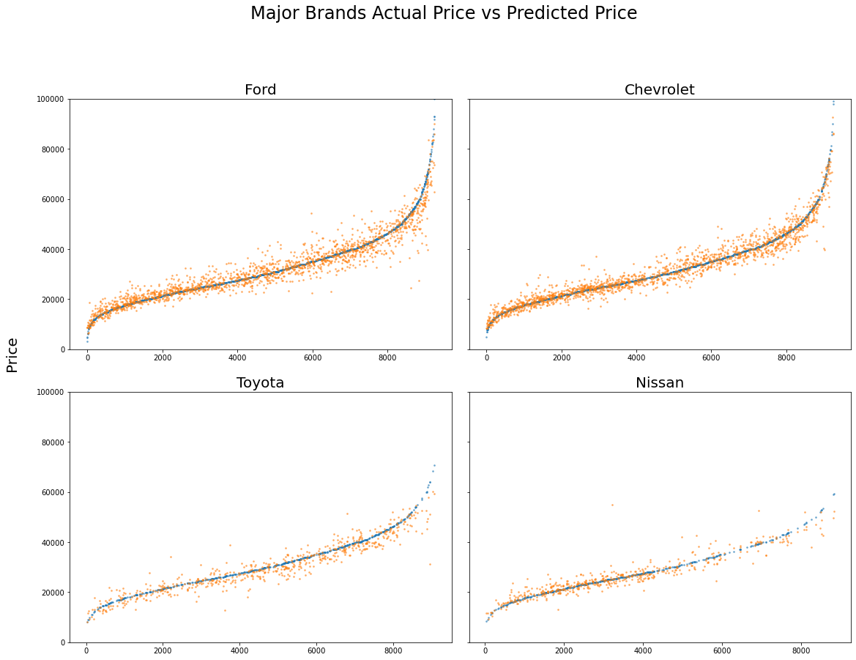

Results
Manufacturer
MAE
For major brands
Ford
Chevrolet
8.58 %
7.39 %
Toyota
Nissan
7.87 %
7.15 %
Notes:
Ford : 8.58% Chevrolet : 7.39% Toyota : 7.87% Nissan : 7.15%
SUV / Crossover : 7.45% Sedan : 9.27%
Hatchback : 15.02%
Wagon : 11.47% Minivan : 7.66% Pickup Truck : 8.19%
Convertible : 16.37% Coupe : 15.86% Van : 8.42%

Slide 28
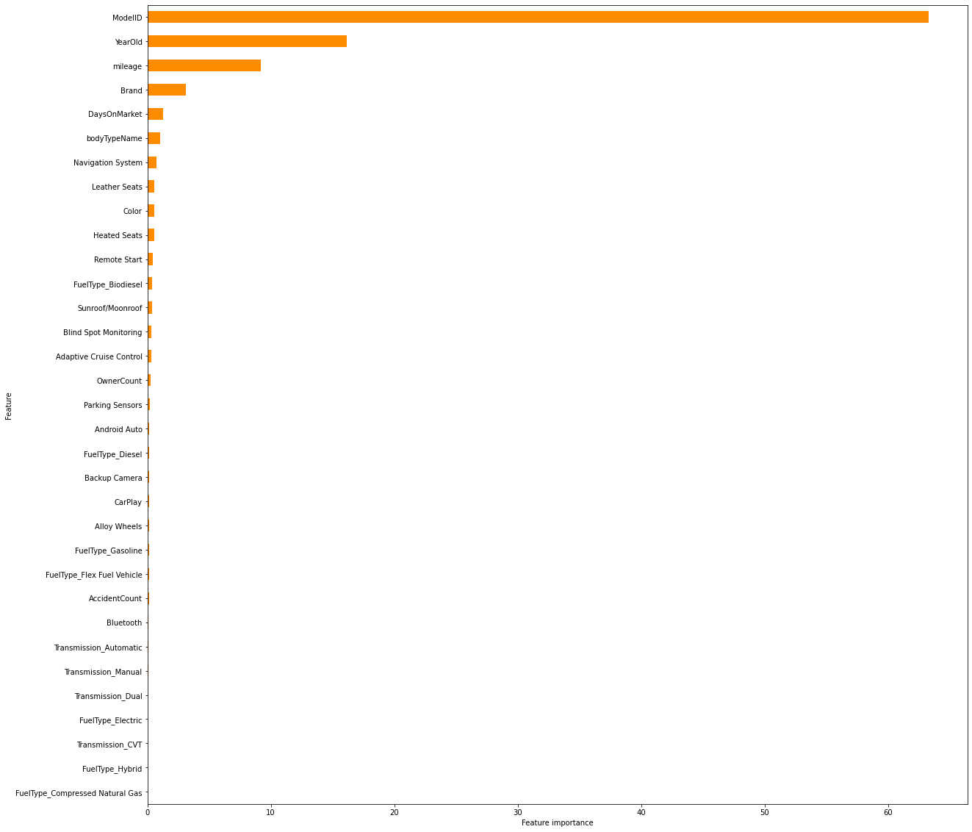

Results
Feature Importance
Key Feature Importance
Model ID
63.27
Year Old
16.14
Mileage
9.18
Brand
3.13

Slide 29
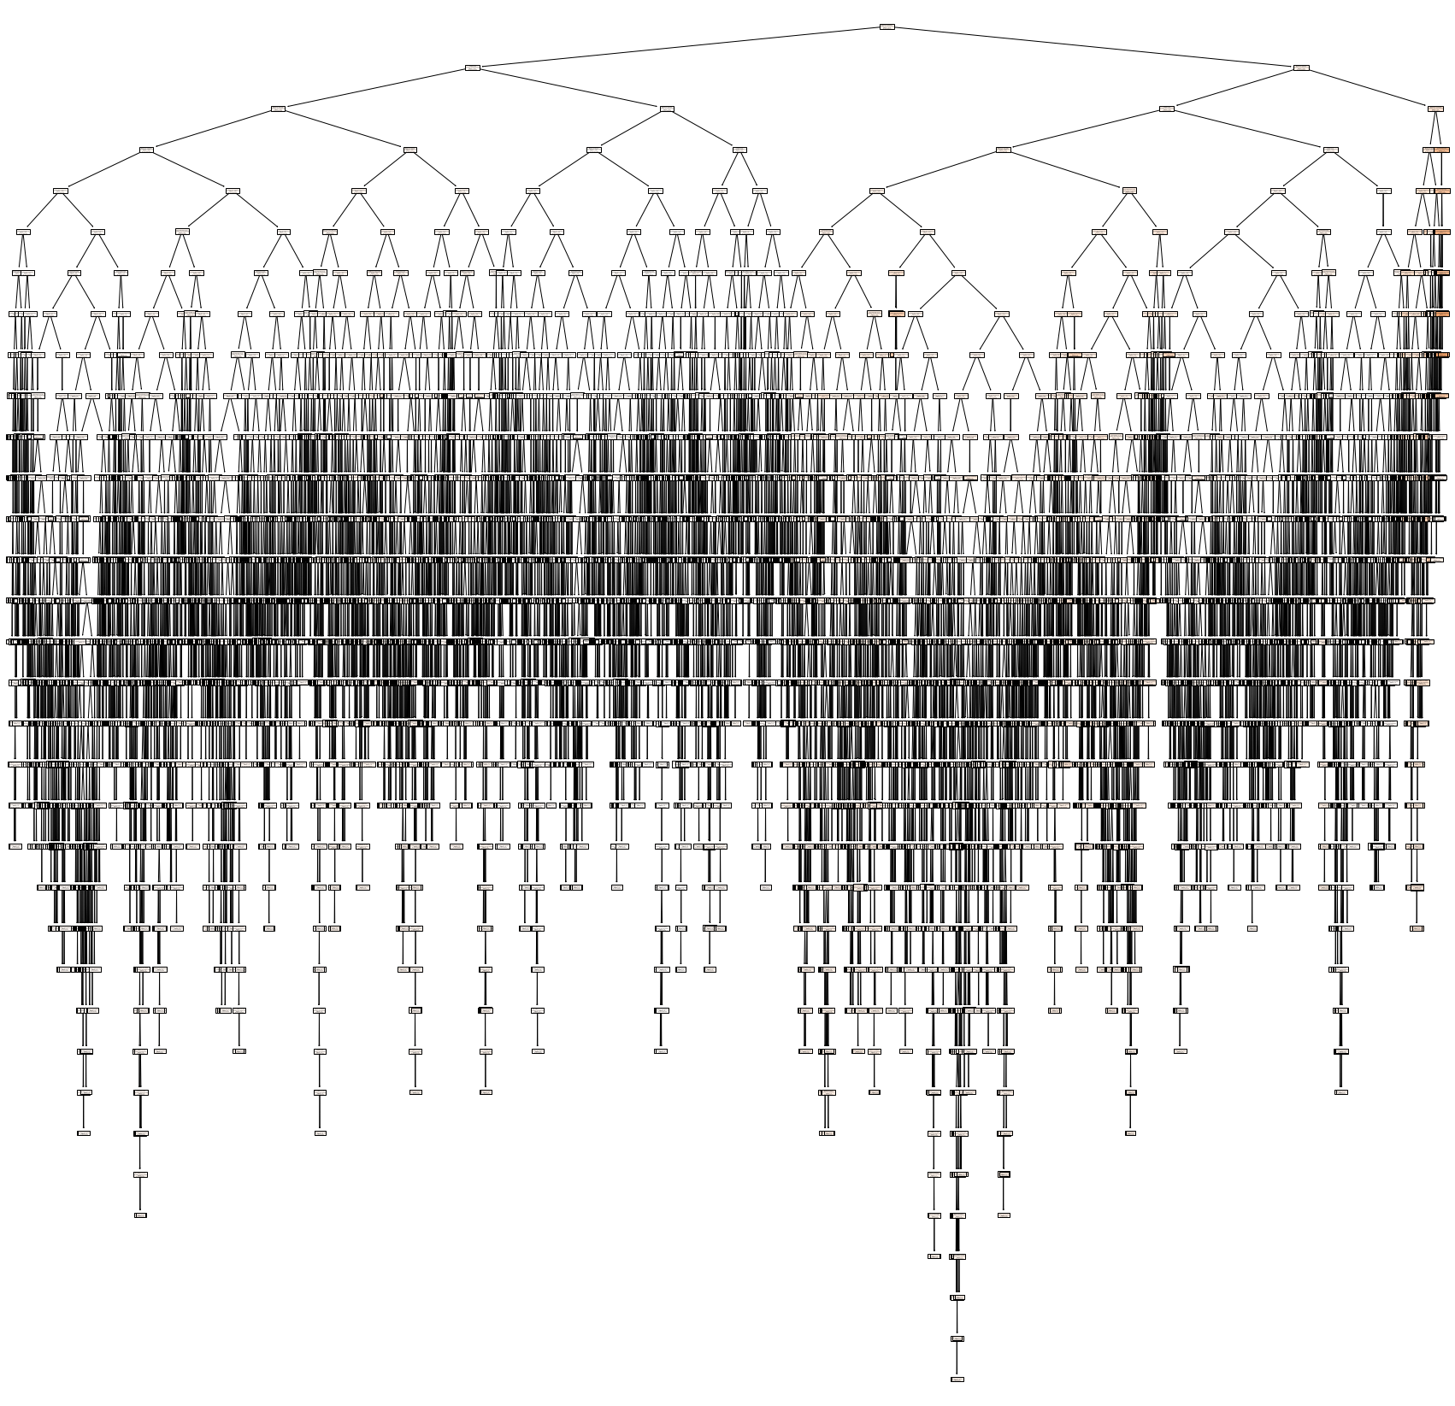
Conclusion
Results
Model performances
Key features importance
Random forest
Model ID
Polynomial regression
Year Old
K-nearest neighbor
Mileage
Linear regression
Brand
Notes:
Randomforest 안정적 + key importance

Slide 30
Conclusion
Challenges
Null
Values
Collinearity
problem
KNN
Scaling
MSRP
Transmission
Fuel type
Body Type
Accident Count
Owner count
Apple Carplay
Vs.
Android auto
Brand & Model & Color..
Vs.
Accident Count & Transmission..
Notes:
The variables with large values were of importance. However, as their size was much larger than some factors such as accident counts, their affect on the model may have caused biased analysis. Once scaling the data appropriately we were able to give almost equal weight onto all variables and thereby leading to a less or non biased model.

Slide 31
Conclusion
Challenges
Drop the missing values
Null
Values
1,770 of 31,015 observations
Remove 5.7%
MSRP
Transmission
Fuel type
Body Type
Accident Count
Owner count
31,015 observations left
Notes:
The variables with large values were of importance. However, as their size was much larger than some factors such as accident counts, their affect on the model may have caused biased analysis. Once scaling the data appropriately we were able to give almost equal weight onto all variables and thereby leading to a less or non biased model.

Slide 32


Conclusion
Challenges
Drop the “Android auto”
Collinearity
problem
Market Share
Apple Carplay
Vs.
Android auto

Slide 33
Conclusion
Scaling Methods
Challenges
KNN
Scaling
Min-max scaling
Standard scaling
Brand & Model & Color..
Vs.
Accident Count & Transmission..
Robust scaling
Notes:
The variables with large values were of importance. However, as their size was much larger than some factors such as accident counts, their affect on the model may have caused biased analysis. Once scaling the data appropriately we were able to give almost equal weight onto all variables and thereby leading to a less or non biased model.

Slide 34
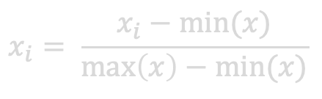
Conclusion
Scaling Methods
Challenges
Min-max scaling
KNN
Scaling
$$x_{i}= \frac{x_{i}−min⁡(x)}{\max\left(x\right)−min⁡(x)}$$
KNN score
63.56%
Brand & Model & Color..
Vs.
Accident Count & Transmission..
MSE
100,904,088
MAE
5177,17
Notes:
The variables with large values were of importance. However, as their size was much larger than some factors such as accident counts, their affect on the model may have caused biased analysis. Once scaling the data appropriately we were able to give almost equal weight onto all variables and thereby leading to a less or non biased model.

Slide 35
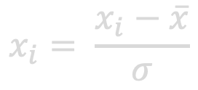
Conclusion
Scaling Methods
Challenges
Standard scaling
KNN
Scaling
$$x_{i}= \frac{x_{i}−\overline{x}}{σ}$$
KNN score
76.14%
Brand & Model & Color..
Vs.
Accident Count & Transmission..
MSE
66,057,754
MAE
4676,74
Notes:
The variables with large values were of importance. However, as their size was much larger than some factors such as accident counts, their affect on the model may have caused biased analysis. Once scaling the data appropriately we were able to give almost equal weight onto all variables and thereby leading to a less or non biased model.

Slide 36
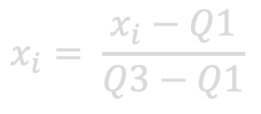
Conclusion
Scaling Methods
Challenges
Robust scaling
KNN
Scaling
$$x_{i}= \frac{x_{i}−Q1}{Q3−Q1}$$
KNN score
81.38%
Brand & Model & Color..
Vs.
Accident Count & Transmission..
MSE
51,542,118
MAE
3843.28
Notes:
The variables with large values were of importance. However, as their size was much larger than some factors such as accident counts, their affect on the model may have caused biased analysis. Once scaling the data appropriately we were able to give almost equal weight onto all variables and thereby leading to a less or non biased model.

Slide 37
Conclusion
Scaling Methods
Challenges
KNN
Scaling
Min-max scaling
63.56%
Standard scaling
76.14%
Brand & Model & Color..
Vs.
Accident Count & Transmission..
Robust scaling
81.38%
Notes:
The variables with large values were of importance. However, as their size was much larger than some factors such as accident counts, their affect on the model may have caused biased analysis. Once scaling the data appropriately we were able to give almost equal weight onto all variables and thereby leading to a less or non biased model.

Slide 38
Conclusion
Scaling the dataset
Challenges
Brand
Model ID
Color
Accident
Owner
32533
52855
15968
0
1.00
KNN
Scaling
Brand
Model ID
Color
Accident
Owner
0.0625
0.1453
0.6971
0.0
0.25
Before
After
Brand & Model & Color..
Vs.
Accident Count & Transmission..
KNN score
81.38 %
77.62 %
MSE
61,969,064
51,542,118
MAE
4643.04
3843.28
Notes:
The variables with large values were of importance. However, as their size was much larger than some factors such as accident counts, their affect on the model may have caused biased analysis. Once scaling the data appropriately we were able to give almost equal weight onto all variables and thereby leading to a less or non biased model.

Slide 39

Conclusion
Limitation
Dataset with enough MSRP will possibly improve prediction model better

Slide 40

Conclusion
Limitation
Key Feature Importance
Model ID
63.27
Year Old
16.14
Mileage
9.18
Brand
3.13
Weighed more to Key Features will improve the prediction model better

Slide 41




Conclusion
Possible Applications
Used flight
Price prediction
Auto Fraud
Monitoring System
Used laptop
Price prediction

Slide 42
Thank you
STAT 432 Final Project

